Slide 1

Could you pick up milk if you are at Safeway, please?

Slide 2
Problem
Trips to the store for just a few items is painful

Slide 3
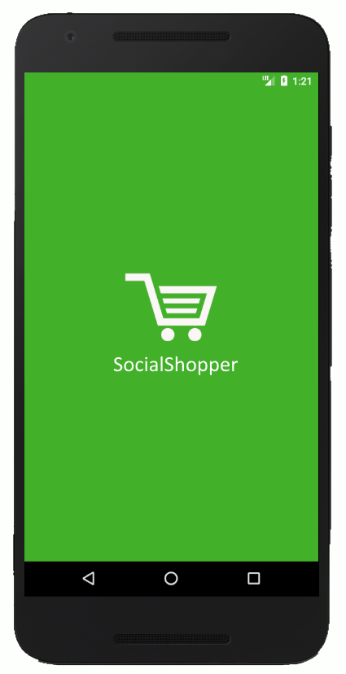

Slide 4
Design Thoughts
Trust
Facebook for Login
1
User Experience
Fun
Fast
Intuitive
2
Messaging
Reaching people when most likely to help
3

Slide 5
video

Slide 6
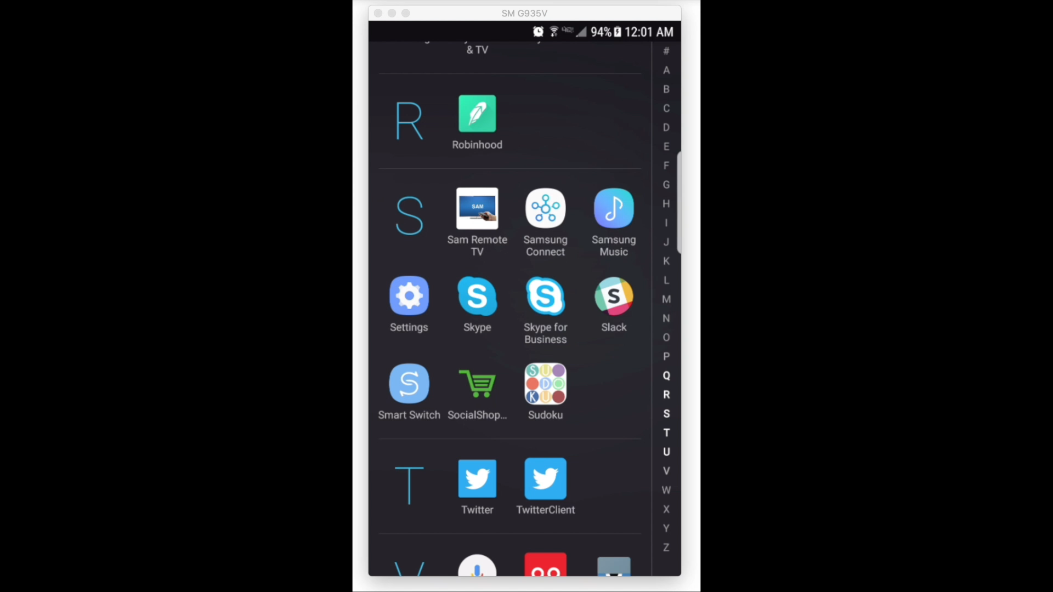

Slide 7
SocialShopper
Sriram Santosh Aripirala
Greeshma Umapathi
Rahul Deshpande

